Slide 1
Ride application
Requirements:
a) Allow a driver to sign-up and enter their profile information
b) Trigger onboarding processes like document collection, background verification, shipping of tracking device, etc.,
c) Allow a driver to mark when they are ready to take a ride

Slide 2
High Level design Components
User/Client - Web/Android/IOS
DNS(Domain name server)
Api Gateway
Ride service -It can handle all operations related to cab availability and bookings etc

Slide 3
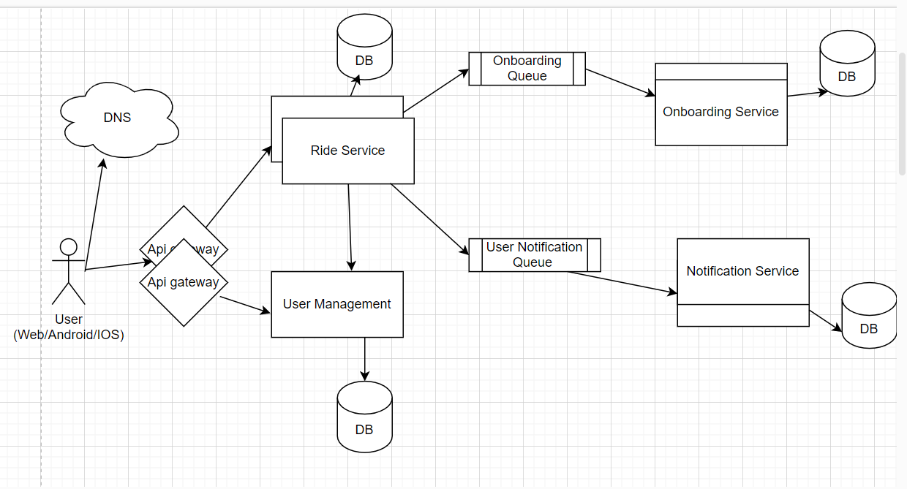

Slide 4
Assumptions & Implementations:
Onboarding service - This service is already implemented that handles onboarding process(Document collection, Background verification & shipping of Tracking device) of Driver once signup is completed on ride service. Once onboarding is completed then that will be notified to ride service that now driver is onboarded.
User Management service - This service is responsible for User signup,login.
SQSUtil - SQSUtil class implemented as Queue that push messages to Queue so flow will work in async(background). Ex- Onboarding Queue & Notification Queue
Authentication - Token based authentication is implemented with no expiry right now but we can add expiry as well as enhancement. Rather than token based authentication jWT can also be used on microservice architecture.

Slide 5
5.) User notification - once user is signed up then a mail will be triggered to user to update password from random generated password by ride service, then that will be stored as encrypted in db.
6.) MYSQL is used for Data storage.
7.) MD5 hash is used for password encryption.
8.) Logging - SL4J lombok
9.) Log tracking - Sl4j MDC(Mapped diagnostic context) is used. Unique identifier for every thread in a application from end to end that helps to track each transaction flow.

Slide 6
Implementation
10.) Application follows MVC architecture - Controller, Service & Repository different layers
11.) Used Builder design pattern
12.) Exception handling - Custom exceptions with exception handler is implemented with handling of type of errorCode and errorMessage.
13.) Junit test cases - Junit is implemented as of now for register driver/signup so we can implement as same for other methods.

Slide 7
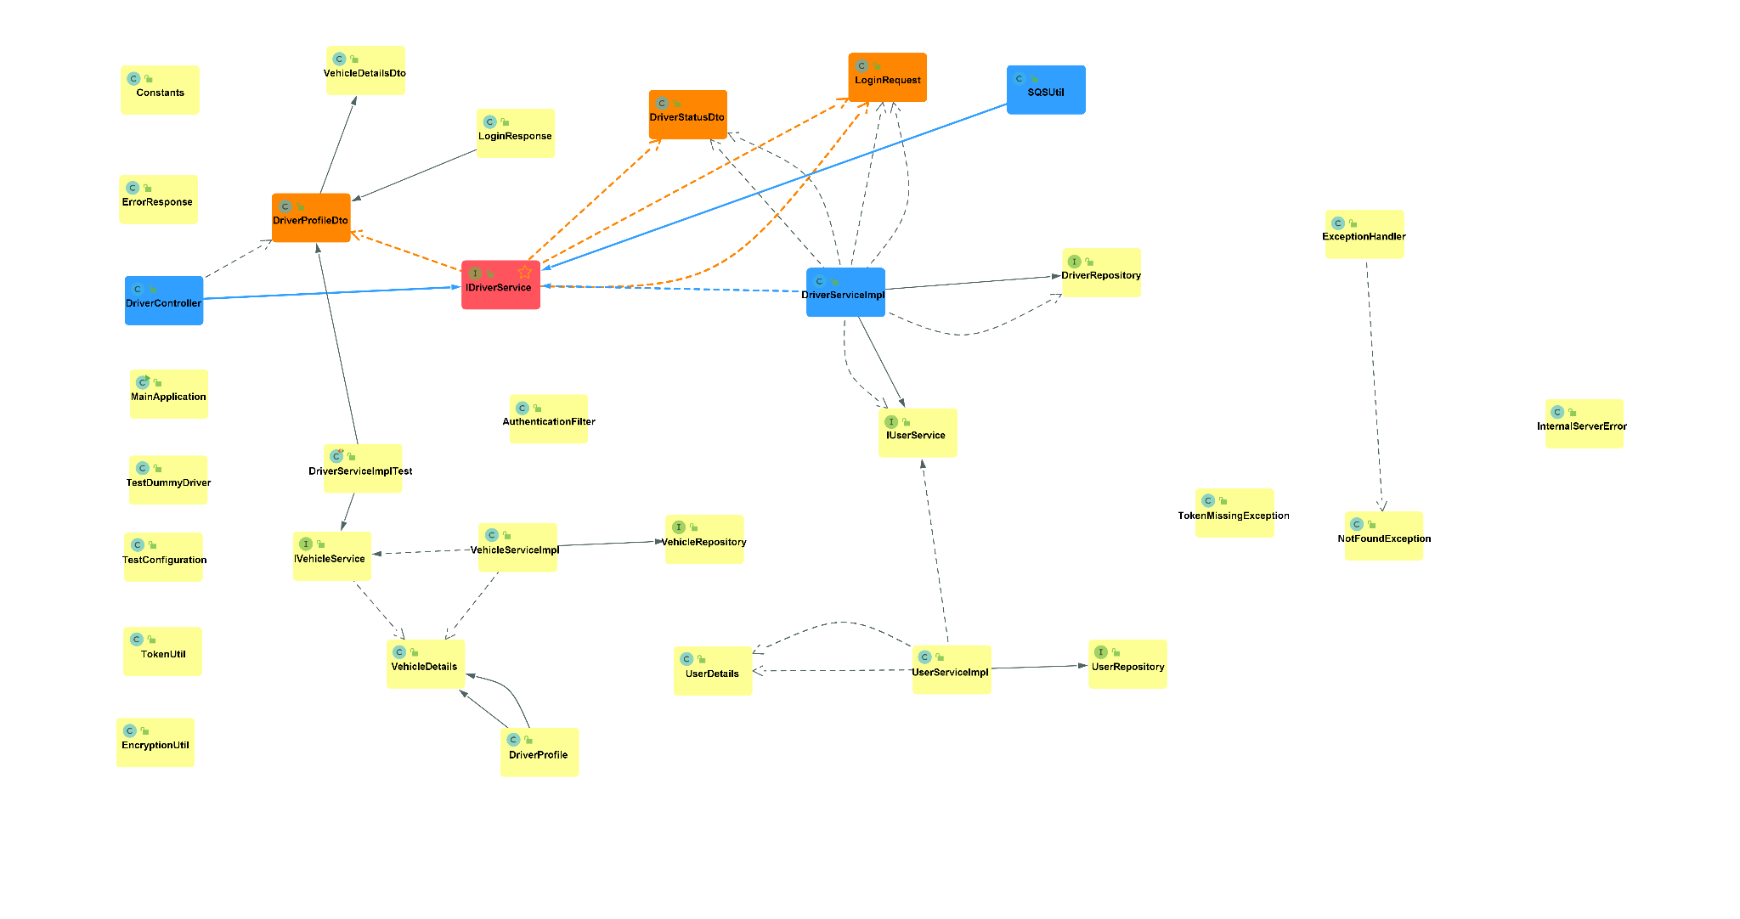

Slide 8
Thanks !!

